Slide 1
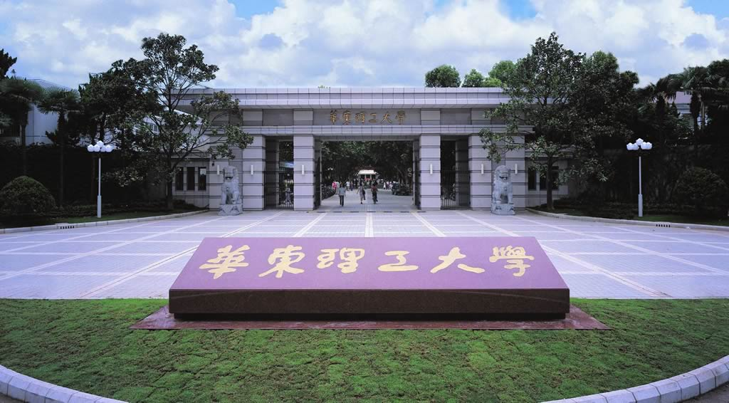
Chapter 7 Techniques for study protein-protein interaction
-- Interaction proteomics
Li-Qiang Fan
East China University of Science and Technolog

Slide 2
Outline
Why study protein-protein interactions？
How to study protein-protein interactions
Experimental methods
Hybrid system
Display system
Affinity-based methods
Visualization PPIs in living cells
Computational prediction methods
Cases and application of protein-protein interactions study

Slide 3
Visualization PPIs in living cells
Modified mammalian two-hybrid system(修饰的哺乳动物双杂交系统）
Fluorescence resonance energy transfer (FRET,荧光能量共振转移)
Bioluminescence resonance energy transfer (BRET，生物发光能量共振转移)
Protein-fragment complementation assay（PCA， 蛋白片段互补分析）
Split Bioluminescence complementation（生物发光互补）
Bimolecular fluorescence complementation (BiFC，双分子荧光互补)
BiFC-FRET(双分子荧光-荧光能量共振转移)
BRET-BiFC(生物发光-双分子荧光互补能量共振转移)

Slide 4
1 Modified mammalian two-hybrid system
more than 50% of all protein interactions described using the yeast two-hybrid system
two proteins are expressed in yeast:
one fused to a DNA-binding domain (BD)
the other fused to a transcription activation domain (AD).
If the two proteins interact, they activate transcription of one or more reporter genes that are distal to binding sites for the BD
a VP16–Gal4 transactivator complex

Slide 5
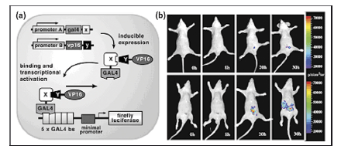

Slide 6
Weintraub H et al
pBIND---containing the yeast GAL4 DNA binding domain
pACT---containing the herpes (疱疹）simplex virus VP16 activation domain
pG5-luc---containing five GAL4-binding sites upstream of a minimal TATA box,followed by the firefly luciferase [Fluc] gene

Slide 7
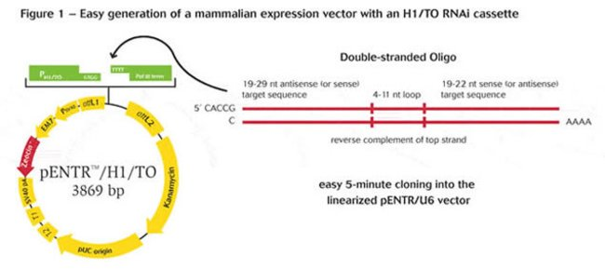
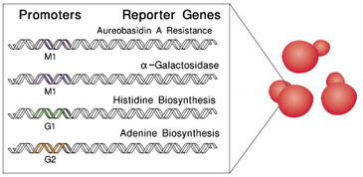
To inducibly modulate the expression
the CMV (cytomegalovirus) promoters of pBIND and pACT were replaced with tumor necrosis factor a (TNFa) inducible nuclear factor kB (NFkB) response elements.

Slide 8
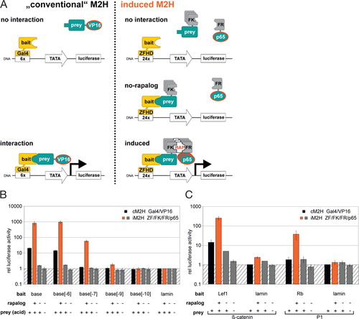
A sensitive, semi-quantitative mammalian two-hybrid assay
BIOTECHNIQUES 2018, 62(5)

Slide 9
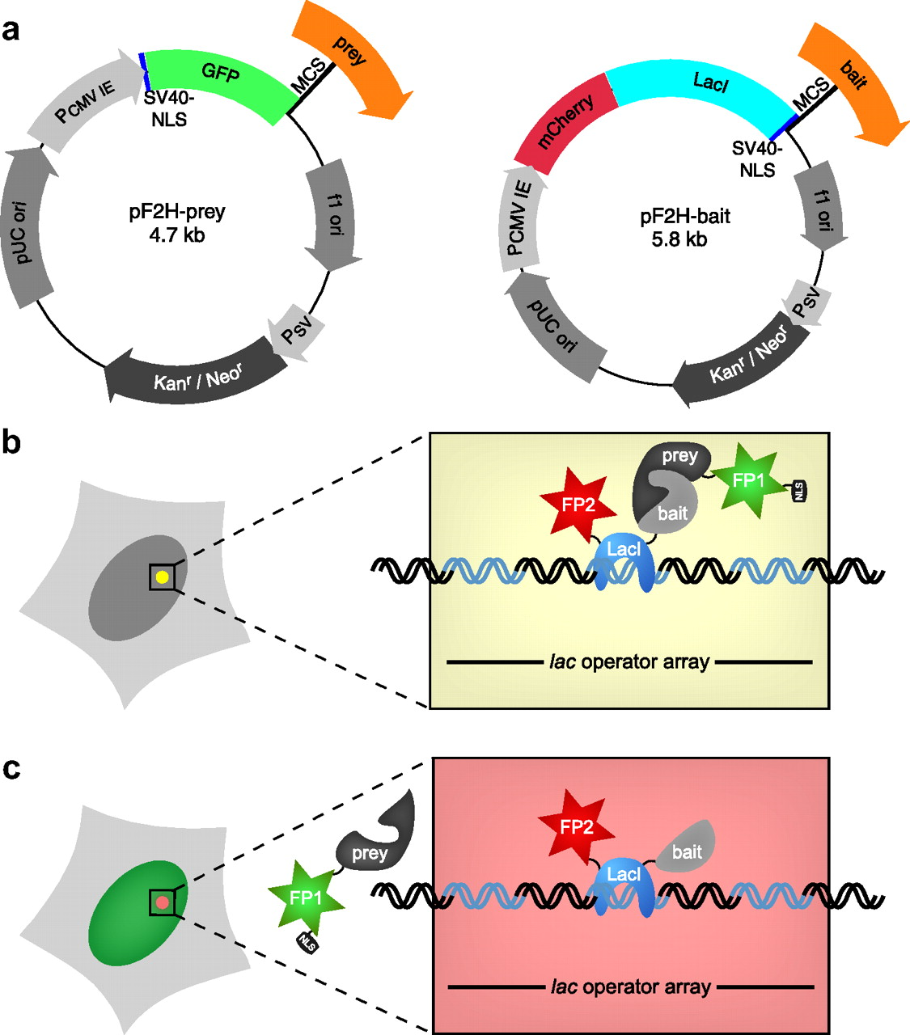
Fluorescent Two-hybrid Assay
Molecular & Cellular Proteomics,
2008,7:2279-87

Slide 10
2 Fluorescence Resonance Energy Transfer (FRET)
Also known as resonance energy transfer (RET) or electronic energy transfer (EET)
Is a distance-dependent interaction between the electronic excited states of two dye molecules in which excitation is transferred from a donor molecule to an acceptor molecule without emission of a photon.
A donor chromophore, initially in its electronic excited state, may transfer energy to an acceptor chromophore (in proximity, typically less than 10nm) through nonradiative dipole–dipole coupling

Slide 11
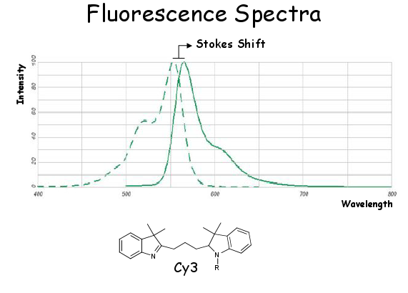
Molecular Energy Level and Fluorescence
1. Energy Level：The possible states of atoms are not continuous, so the corresponding energies of each state are also discontinuous. Including electronic energy level, vibration energy level and rotational energy level
2. Fluorescence：When a molecule in the ground state absorbs light energy, it enters the excited state and immediately returns to the ground state and releases energy in the form of light, which is called fluorescence。
3. Phosphorescence）:Molecules return to the ground state from the excited triplet state to release energy in the form of light,which is called phosphorescence。
4. Excitation( Ex) Spectra and Emission(Em) Spectra
S₁
T₁
hν₀
hν₁
hν₂
S₀

Slide 12
Fluorescence Resonance Energy Transfer（FRET）
In two different fluorescent groups, if the emission spectra of one group (Donor) overlap with the absorption spectra of another group (Acceptor), the transfer of fluorescent energy from donor to acceptor can be observed when the distance between the two fluorescent groups is appropriate (1-10 nm). That is, when the excitation wavelength of the former group excites, fluorescence emitted by the latter group can be observed.
Conditions for Effective Energy Transfer
The emission spectra of energy donors and the absorption spectra of energy receptors must overlap.
The fluorescent chromophores of energy donors and energy receptors must be arranged in an appropriate way.
The energy donor and the energy receptor must be close enough.

Slide 13
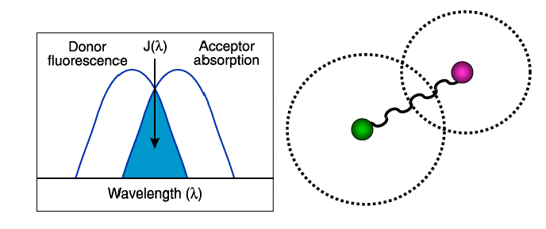
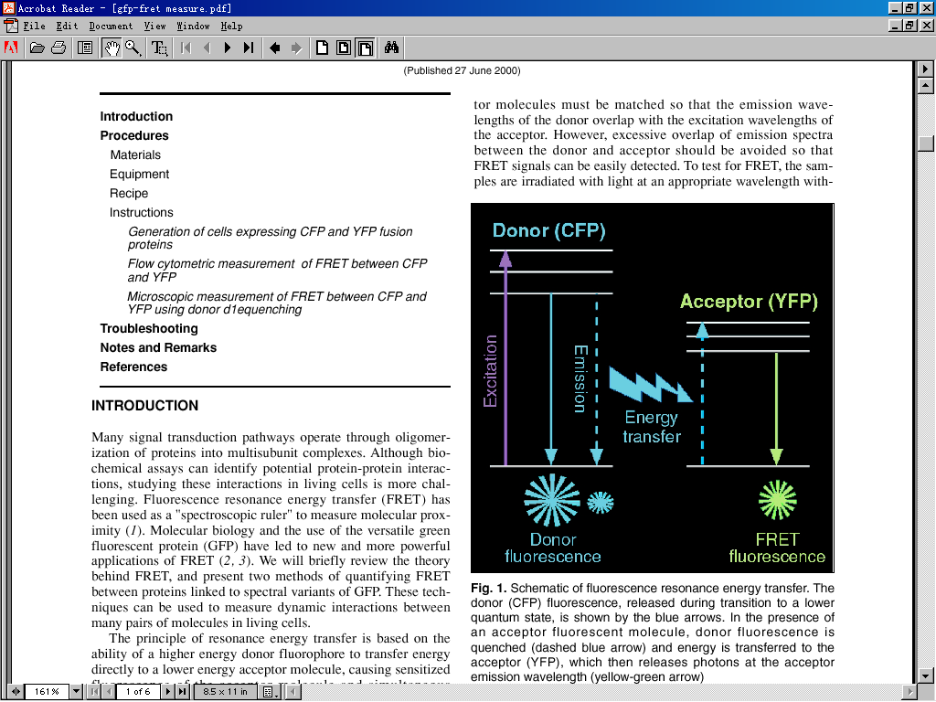
Principle of FRET

Slide 14
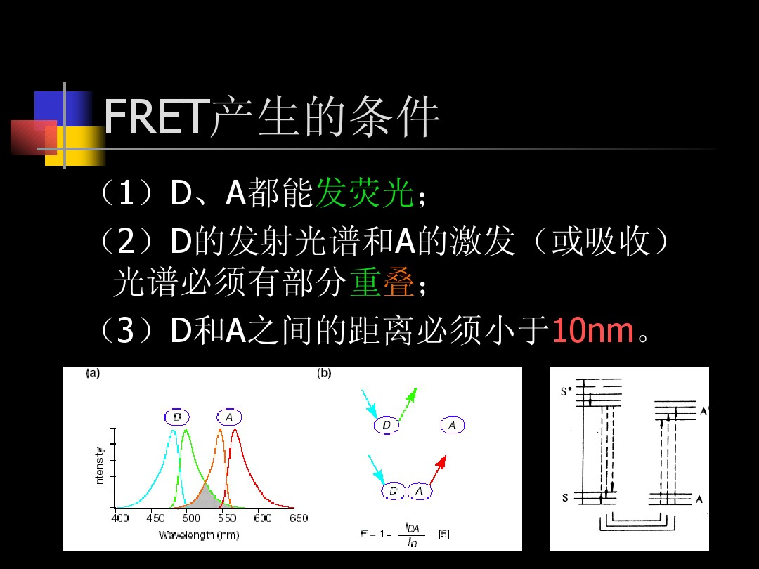

Slide 15
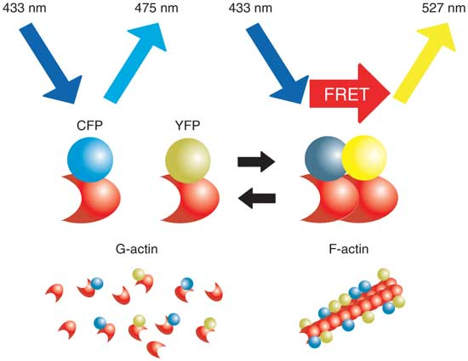
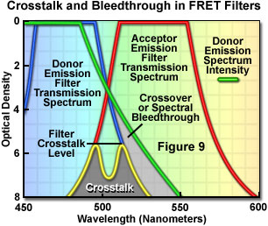
Principle of FRET
When the two fluorescent chromophores are close enough, the donor molecule absorbs a certain frequency of photons and is stimulated to a higher electronic energy state. Before the electron returns to the ground state, energy transfer to the adjacent acceptor molecule (i.e., energy resonance transfer) is realized by dipole interaction.

Slide 16
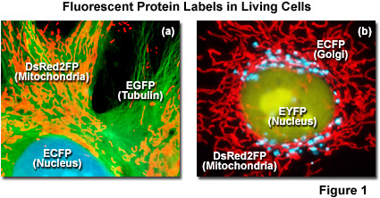

Slide 17
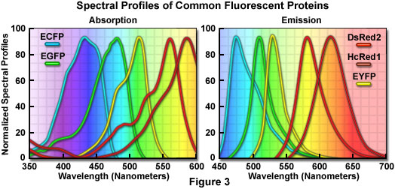
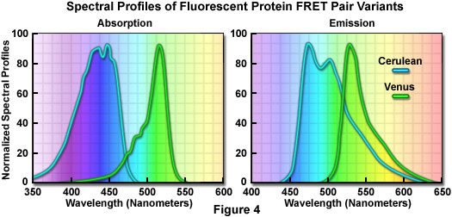

Slide 18
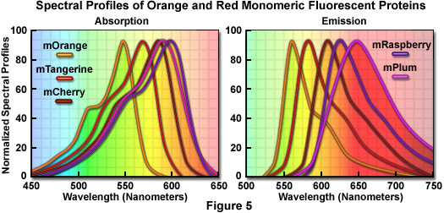

Slide 19
Fluorescent Protein Properties
Protein (Acronym) | Excitation Maximum(nm) | Emission Maximum(nm) | Molar Extinction Coefficient | Quantum Yield | in vivo Structure | Relative Brightness (% of EGFP)
GFP (wt) | 395/475 | 509 | 21,000 | 0.77 | Monomer* | 48
Green Fluorescent Proteins
EGFP | 484 | 507 | 56,000 | 0.60 | Monomer* | 100
Emerald | 487 | 509 | 57,500 | 0.68 | Monomer* | 116
Superfolder GFP | 485 | 510 | 83,300 | 0.65 | Monomer* | 160
Azami Green | 492 | 505 | 55,000 | 0.74 | Monomer | 121
mWasabi | 493 | 509 | 70,000 | 0.80 | Monomer | 167
TagGFP | 482 | 505 | 58,200 | 0.59 | Monomer* | 110
TurboGFP | 482 | 502 | 70,000 | 0.53 | Dimer | 102
AcGFP | 480 | 505 | 50,000 | 0.55 | Monomer* | 82
ZsGreen | 493 | 505 | 43,000 | 0.91 | Tetramer | 117
T-Sapphire | 399 | 511 | 44,000 | 0.60 | Monomer* | 79

Slide 20
Fluorescent Protein Properties
Protein (Acronym) | Excitation Maximum(nm) | Emission Maximum(nm) | Molar Extinction Coefficient | Quantum Yield | in vivo Structure | Relative Brightness (% of EGFP)
GFP (wt) | 395/475 | 509 | 21,000 | 0.77 | Monomer* | 48
Blue Fluorescent Proteins
EBFP | 383 | 445 | 29,000 | 0.31 | Monomer* | 27
EBFP2 | 383 | 448 | 32,000 | 0.56 | Monomer* | 53
Azurite | 384 | 450 | 26,200 | 0.55 | Monomer* | 43
mTagBFP | 399 | 456 | 52,000 | 0.63 | Monomer | 98
Cyan Fluorescent Proteins
ECFP | 439 | 476 | 32,500 | 0.40 | Monomer* | 39
mECFP | 433 | 475 | 32,500 | 0.40 | Monomer | 39
Cerulean | 433 | 475 | 43,000 | 0.62 | Monomer* | 79
CyPet | 435 | 477 | 35,000 | 0.51 | Monomer* | 53
AmCyan1 | 458 | 489 | 44,000 | 0.24 | Tetramer | 31
Midori-Ishi Cyan | 472 | 495 | 27,300 | 0.90 | Dimer | 73
TagCFP | 458 | 480 | 37,000 | 0.57 | Monomer | 63

Slide 21
Fluorescent Protein Properties
Protein (Acronym) | Excitation Maximum(nm) | Emission Maximum(nm) | Molar Extinction Coefficient | Quantum Yield | in vivo Structure | Relative Brightness (% of EGFP)
Yellow Fluorescent Proteins
EYFP | 514 | 527 | 83,400 | 0.61 | Monomer* | 151
Topaz | 514 | 527 | 94,500 | 0.60 | Monomer* | 169
Venus | 515 | 528 | 92,200 | 0.57 | Monomer* | 156
mCitrine | 516 | 529 | 77,000 | 0.76 | Monomer | 174
YPet | 517 | 530 | 104,000 | 0.77 | Monomer* | 238
TagYFP | 508 | 524 | 64,000 | 0.60 | Monomer | 118
PhiYFP | 525 | 537 | 124,000 | 0.39 | Monomer* | 144
ZsYellow1 | 529 | 539 | 20,200 | 0.42 | Tetramer | 25
mBanana | 540 | 553 | 6,000 | 0.7 | Monomer | 13

Slide 22
Protein (Acronym) | Excitation Maximum(nm) | Emission Maximum(nm) | Molar Extinction Coefficient | Quantum Yield | in vivo Structure | Relative Brightness (% of EGFP)
Orange Fluorescent Proteins
Kusabira Orange | 548 | 559 | 51,600 | 0.60 | Monomer | 92
Kusabira Orange2 | 551 | 565 | 63,800 | 0.62 | Monomer | 118
mOrange | 548 | 562 | 71,000 | 0.69 | Monomer | 146
mOrange2 | 549 | 565 | 58,000 | 0.60 | Monomer | 104
dTomato | 554 | 581 | 69,000 | 0.69 | Dimer | 142
dTomato-Tandem | 554 | 581 | 138,000 | 0.69 | Monomer | 283
TagRFP | 555 | 584 | 100,000 | 0.48 | Monomer | 142
TagRFP-T | 555 | 584 | 81,000 | 0.41 | Monomer | 99
DsRed | 558 | 583 | 75,000 | 0.79 | Tetramer | 176
DsRed2 | 563 | 582 | 43,800 | 0.55 | Tetramer | 72
DsRed-Express (T1) | 555 | 584 | 38,000 | 0.51 | Tetramer | 58
DsRed-Monomer | 556 | 586 | 35,000 | 0.10 | Monomer | 10

Slide 23
Protein (Acronym) | Excitation Maximum(nm) | Emission Maximum(nm) | Molar Extinction Coefficient | Quantum Yield | in vivo Structure | Relative Brightness (% of EGFP)
Red Fluorescent Proteins
mRuby | 558 | 605 | 112,000 | 0.35 | Monomer | 117
mApple | 568 | 592 | 75,000 | 0.49 | Monomer | 109
mStrawberry | 574 | 596 | 90,000 | 0.29 | Monomer | 78
AsRed2 | 576 | 592 | 56,200 | 0.05 | Tetramer | 8
mRFP1 | 584 | 607 | 50,000 | 0.25 | Monomer | 37
JRed | 584 | 610 | 44,000 | 0.20 | Dimer | 26
mCherry | 587 | 610 | 72,000 | 0.22 | Monomer | 47
HcRed1 | 588 | 618 | 20,000 | 0.015 | Dimer | 1
mRaspberry | 598 | 625 | 86,000 | 0.15 | Monomer | 38
dKeima-Tandem | 440 | 620 | 28,800 | 0.24 | Monomer | 21
HcRed-Tandem | 590 | 637 | 160,000 | 0.04 | Monomer | 19
mPlum | 590 | 649 | 41,000 | 0.10 | Monomer | 12

Slide 24
Common Donor and Acceptor Pairs used in FRET
Dyes
FITC - Rhodamine
Alexa 488 - Cy3
Cy3 - Cy5
Fluorescent Proteins
BFP - GFP
BFP - RFP
CFP - YFP
CFP - dsRED
GFP - dsRED

Slide 25
Application of FRET
Spatial information about the interaction between two protein molecules can be obtained by FRET technology, which is often used to solve the following problems:
1) Co-localization of protein molecules;
2) Protein molecular polymer;
3) Transcription mechanism;
4) Conversion pathway;
5) Molecular movement;
6) protein folding;
7) Real-time PCR
etc

Slide 26
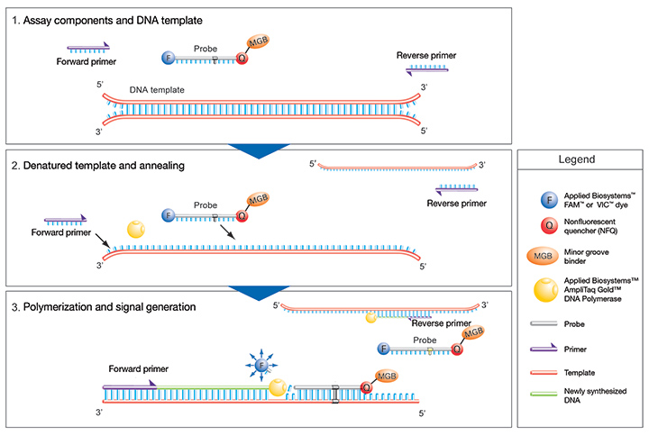
Real-time PCR
TaqMan MGB Probes incorporate a 5' fluorescent reporter dye and a 3' nonfluorescent quencher

Slide 27
Co-localization
Laser
Laser
D
A

Slide 28
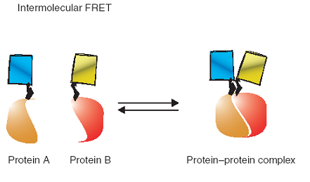
Protein-protein interaction (complex)
Laser

Slide 29
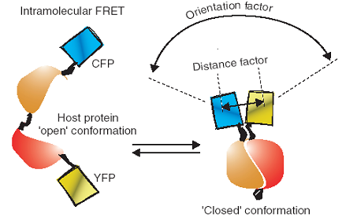
Protein folding and conformation changing
Laser

Slide 30
The use of fluorescence resonance energy transfer (FRET) to study the interaction between CD147 and MCT1
Potential combinations of CFP- and YFP-tagged CD147 and MCT1
N
-
terminus
OR
YFP
YFP
CFP
CFP
MCT1
s
s
CD147
s
s
Membrane
N
-
terminus
C
-
terminus
CFP
YFP
CFP
YFP
YFP
YFP
CFP
CFP
OR
CFP
OR
YFP
CFP
YFP
C
-
terminus
OR
Energy transfer from excitation of the donor molecule (CFP) to the acceptor molecule (YFP) will occur only if the molecules are less than100Å apart. This causes quenching of donor fluorescence and excitation of the acceptor at its emission wavelength.
The principle of FRET

Slide 31
FRET occurs between
MCT1
n
CFP
and
CD147
c
YFP
but not between
MCT1
n
CFP
and
CD147
n
YFP
30
25
Co-transfection with MCT1cCFP + CD147nYFP
20
CFP laser excitation
MCT1
intensity
15
10
No FRET
5
0
CFP
Single
transfection
N
460
480
500
520
540
560
580
600
MCT1nCFP
Emission wavelength nm
14
12
YFP laser excitation
CD147
10
YFP
8
No FRET
CD147
MCT1
YFP
intensity
6
s
YFP
s
YFP
s
4
s
2
s
s
0
s
s
CFP
460
480
500
520
540
560
580
600
CFP
Emission wavelength nm
Single
transfection
25
CFP laser excitation
CD147cYFP
20
12
15
10
CFP laser excitation
intensity
No FRET
10
8
FRET
MCT1
CD147
5
6
0
intensity
s
s
s
460
480
500
520
540
560
580
600
4
s
Emission wavelength nm
YFP
YFP laser excitation
CFP
YFP
2
CFP
30
Co
-
0
transfection
20
460
480
500
520
540
560
580
600
MCT1nCFP + CD147cYFP
intensity
Emission wavelength nm
10
0
460
480
500
520
540
560
580
600
Emission wavelength nm

Slide 32
3 Bioluminescence resonance energy transfer (BRET)
Developed in 1999
Based on the non-radioactive efficient Resonance Energy Transfer (RET) between a bioluminescent donor moiety and a fluorescent acceptor moiety
Mostly used---in the presence of its substrate, coelenterazine, Renilla luciferase (Rluc, the luminescent energy donor) transfers some energy to a GFP variant (YFP or GFP2, the energy acceptor).
http://what-when-how.com/proteomics/bioluminescence-resonance-energy-transfer-proteomics/

Slide 33
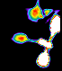
Bioluminescence resonance energy transfer (BRET) 生物发光共振转移
Involving non-radioactive transfer of energy between from a bioluminescent donor molecule, e.g. Renilla luciferase to a fluorescent acceptor molecule, like green fluorescent protein (GFP).
The energy transfer primarily depends on two factors
an overlap between the emission and excitation spectra of the donor and acceptor molecules, respectively
the close proximity of the donor and the acceptor entities (<100 Å)
Notes:
33
A limitation of FRET is the requirement for external illumination to initiate the fluorescence transfer, which can lead to background noise in the results from direct excitation of the acceptor or to photobleaching. To avoid this drawback, Bioluminescence Resonance Energy Transfer (or BRET) has been developed.[24] This technique uses a bioluminescent luciferase (typically the luciferase from Renilla reniformis) rather than CFP to produce an initial photon emission compatible with YFP.

Slide 34
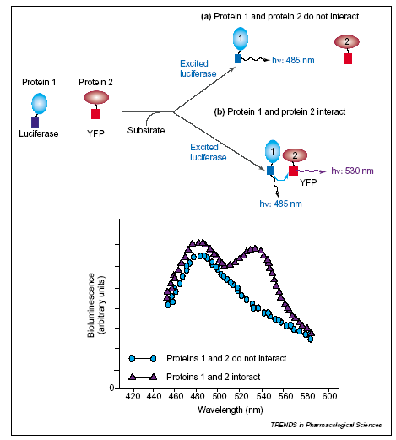
Bioluminescence resonance energy transfer (BRET)

Slide 36
4 Protein-fragment complementation assay（PCA）
Based on the fusion of the hypothetical binding partners（bait and prey）to two rationally designed non-active fragments of a reporter protein
The interaction between bait and prey proteins brings the split reporter fragments close enough to enable their non-covalent and specific reassembly followed by the recovery of its native structure and activity
Notes:
based on the formation of a bimolecular complex when two rationally designed non-active fragments of a reporter protein are brought together due to an interaction between bait and prey (where both are fused to the split domains of the reporter)

Slide 37
Principle of PCA
A single reporter protein/enzyme is cleaved into N-terminal and C-terminal segments
Each segment is fused to one of two interacting proteins (X and Y)
Physical interaction between X and Y reconstitutes the functional reporter protein, leading to signal generation that can be measured

Slide 38
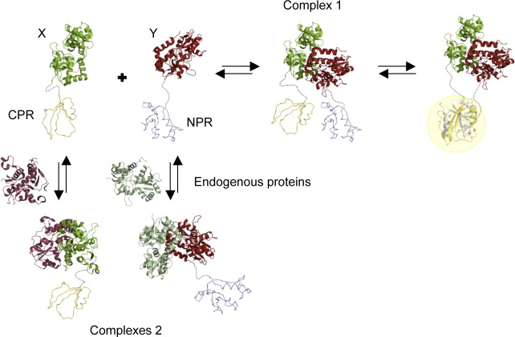
The folding and activity of the protein reporter depends completely on the interaction between prey and bait.

Slide 39
Protein reporters
Dihydrofolate reductase (DHFR)--first reporter
β-lactamase
TEV protease
Green fluorescent protein (GFP) or its variants--simplest reporter
Luminescent proteins
etc
Results:
colour
cell survival
fluorescence
Notes:
DHFR: the first PCA reporter. cell survival (using methotrexate（氨甲喋呤）, a DHFR inhibitor) or fluorescence (in the presence of a fluorescent substrate)
The simplest reporters are FPs because the readout is directly provided by the protein fluorophore and there is no need of any substrate (as in the case of luminescent proteins or DHFR)

Slide 40
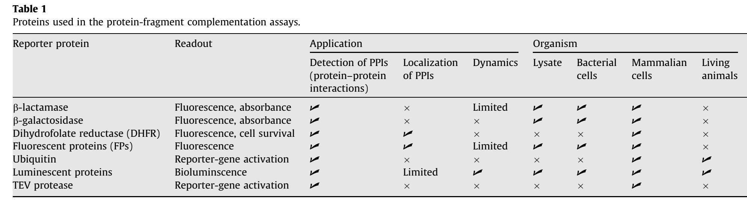

Slide 41
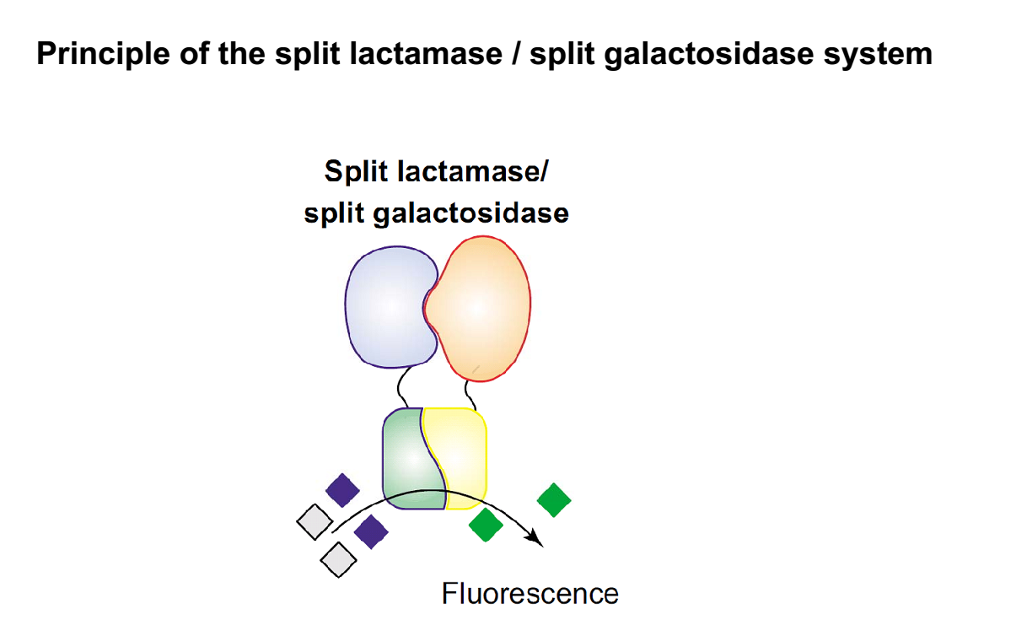
Problem: response is indirect and often not proportional to the interaction strength

Slide 42
Design
Select Protein reporter
Protein reporter fragments
Linker
sequence of serines and glycines that provides polarity and flexibility to the protein fusion
10aa
Topology of the protein fusions
Expression system
high expression levels might result in non-native interactions, complex miss-localization or spontaneous reassembly of the protein reporter fragments
use of endogenous promoters is highly advisable.
Controls
Notes:
false positive
the dissected fragments should not associate spontaneously in the absence of the binding proteins
it is advisable to express the protein fusions at low levels, close to those of the endogenous counterparts, if possible

Slide 43
4.1 Split luminescent proteins
Luminescent reporters
Renilla luciferases
Firefly luciferases
Gaussia luciferase (Gluc)
Because enzymes process a substrate to generate bioluminescence， substrate has to be added in the system in order to obtain a signal

Slide 44
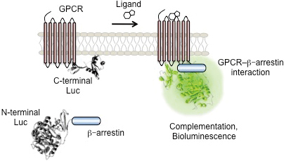
Split Luciferase Complementation for Analysis of Intracellular Signaling. Analytical Sciences. 2014,30(5): 539-544

Slide 45
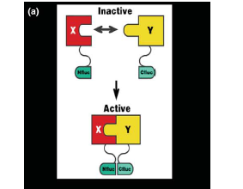
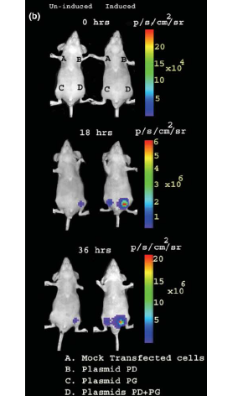
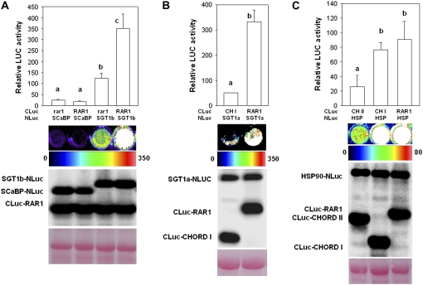
Split luciferase system
Firefly LUC fragments 2-416 (NLuc) and 398-550 (CLuc) were successfully used for protein-protein interaction assays in the mammalian system (Luker et al., 2004).

Slide 46
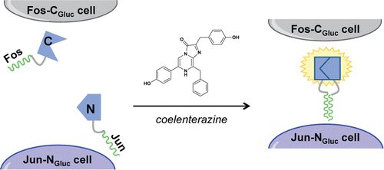
Cell–cell interaction
“split” fragments of Gaussia luciferase (Gluc) fused to the leucine zipper domains of Fos and Jun.
When cells secreting the fragments draw near one another, Fos and Jun drive the assembly of functional, light-emitting Gluc.
Photon production thus provides a readout on the distance between two cell types.
Visualizing Cell Proximity with Genetically Encoded Bioluminescent Reporters. ACS Chem. Biol., 2015, 10 (4), pp 933–938

Slide 47
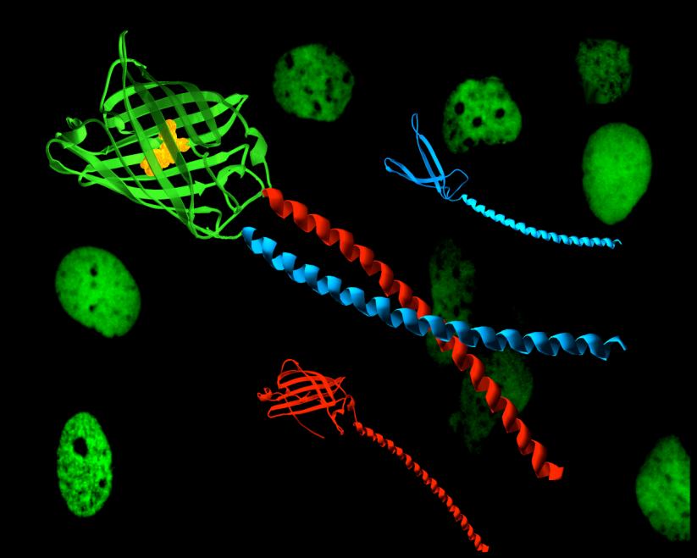
4.2 Bimolecular fluorescence complementation (BiFC) assay
A technology typically used to validate protein interactions
Based on the structural complementation of two nonfluorescent N- and C-terminal fragments of a fluorescent protein when they are fused to a pair of interacting proteins.

Slide 48
Principle of BiFC assay
Two fragments (YN and YC) of the yellow fluorescent protein (YFP) are
fused to two putative interaction partners (A and B)
excitation peak is 514nm and its emission peak is 527nm.
An interaction between the proteins facilitates association between the
fragments to produce a bimolecular fluorescent complex
YN and YC do not interact on their own

Slide 49
Principle of BiFC assay--Split fluorescent proteins
A Novel Pair of Split Venus Fragments to Detect Protein–Protein Interactions by In Vitro and In Vivo Bimolecular Fluorescence Complementation Assays. Methods in Molecular Biology Volume 1174, 2014, pp 247-262

Slide 50
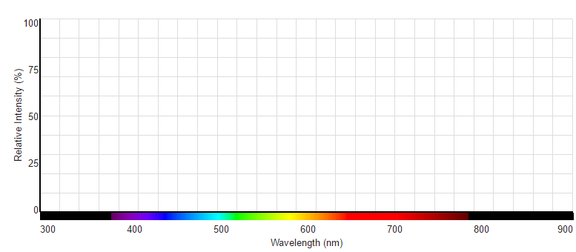
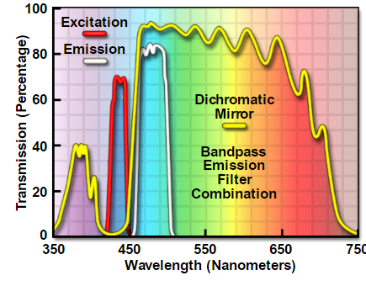
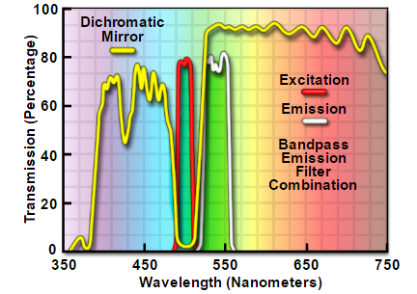
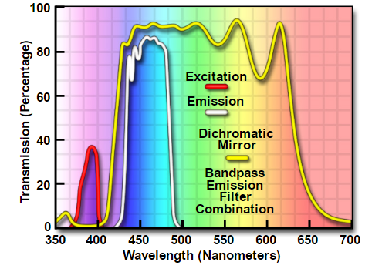
Green Fluorescent Protein and Its Variants
Green Fluorescent Protein (GFP)
Excitation 395; Blue
Emission 509nm
Cyan Fluorescent Protein (CFP)
Tyr66Trp
Excitation 426-446nm; Blue-Violet
Emission 460-500nm
Yellow Fluorescent Protein (YFP)
Thr203Tyr（aromatic amino acids ）
Excitation 490-510nm; Blue-Green
Emission 520-550nm
The earliest BiFC
Blue fluorescent protein (BFP)
Tyr145Phe
Excitation 379-401nm; Violet
Emission 435-485nm
https://www.thermofisher.com/cn/zh/home/life-science/cell-analysis/labeling-chemistry/fluorescence-spectraviewer.html

Slide 51
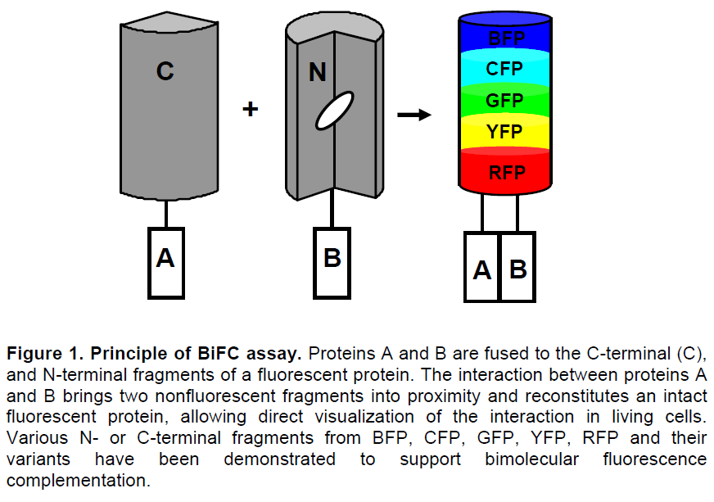
Principle of BiFC assay

Slide 52
Common Segmentation Location
GFP and its varients--- 155 or173
1-154（N155） 155-238（C155）
1-172 （N173） 173-238（C173）
mCherry--136/137、159/160、174/175
1-136（N136） 136-238（C136）
1-159 （N159） 159-238（C159）
1-174（N174） 174-238（C174）
587/610nm
new sites in Venus--210
1-210（VN210） 210-238（VC210 ）

Slide 53
Complementary fragments | Excitation/emission wavelength
YN155-YC155 | 515/527
YN173-YC173 | 515/527
VN155-VC155 | 515/527
VN173-VC173 | 515/527
YN155-CC155 | 503/515
CN155-CC155 | 452/478
CN173-CC155 | 452/478
CN173-YC173 | 466/497
GN173-YC173 | 513/521
GN173-CC173 | 488/512

Slide 54
color | Excitation wavelength | Emission wavelength | N-terminal fragment | C--terminal fragment
Green | 475 | 505 | GFP N157 | GFP C157
 | 503 | 515 | YN155 | CC155
 | 503 | 515 | YN173 | CC155
 | 488 | 512 | GN173 | CC155
 | 466 | 497 | CN173 | YC173
Cyan | 452 | 478 | CN155 | CC155
 | 452 | 478 | CN173 | CC155
 | 456 | 478 | Cerulean N155 | Venus C155
 | 439 | 479 | Cerulean N155 | CC155
Yellow | 513 | 521 | YN173 | YC173
 | 513 | 521 | GN173 | YC173
 | 517 | 527 | Citrine N173 | YC155
 | 515 | 528 | Venus N155 | Venus C155
 | 515 | 528 | Venus N173 | Venus C173
 | 526 | 528 | Venus N173 | YC155
 | 526 | 528 | Citrine N173 | Venus C155
 | 516 | 529 | Citrine N155 | Citrine C155
 | 516 | 529 | Citrine N173 | Citrine C173
Red | 549 | 570 | mRFP N168 | mRFP C169
 | 549 | 570 | mRFP N168 | mRFP C155
 | 587 | 610 | mCherry N159 | mCherry C160
 |  |  | mKate S158A N151 | mKate S158A C152

Slide 55
Split fluorescent proteins--Bimolecular Fluorescent Complementation(BIFC)
fluorescent protein | N-part | C-part
Green Fluorescent protein(GFP) | NG155 NG173 | CG155 CG173
Blue Fluorescent protein(BFP) | NB155 NB173 | CB155 CB173
Cyan fluorescent protein(CFP) | NC155 NC173 | CC155 CC173
Yellow fluorescent protein(YFP) | NY155 NY173 | CY155 CY173 | 503nm 515nm | 515nm 527nm
mCherry | 136/137 159/160 174/175 |  | 587nm | 610 nm
venus | VN210 (amino acids 1–210) | VC210 (amino acids 210–238)

Slide 56
Bimolecular Fluorescence Complementation (BiFC): Pros
Enables direct visualization of protein interactions and does not rely on their secondary effects
Interactions can be visualized in living cells, eliminating potential artifacts associated with cell lysis or fixation
Proteins are expressed in a relevant biological context, ideally at levels comparable to their endogenous counterparts
Enables determination of the subcellular sites of protein interactions
BiFC assay does not require stoichiometric complex formation but can detect interactions between subpopulations of each protein
BiFC does not require specialized equipment, apart from an inverted fluorescence microscope equipped with objectives that allow imaging of fluorescence in cells

Slide 57
Making BiFC Better
Limitation 1
Originally based on the complementation of two nonfluorescent N- and C-terminal fragments from an enhanced yellow fluorescent protein (EYFP)
YPF chromophore maturation sensitivity to higher temperatures requires preincubation at lower temperatures （30℃ 0-24hr） prior to visualization
Overcome
less sensitive to the environment
fluorescence intensity ~10× higher
Shortens incubation time→ 2-fold increase in specific BiFC signals
Venus protein, generated from EYFP with several mutations: F46L, F64L, M153T, V163A, and S175G
Citrine，generated from EYFP with several mutations: S65G，V68L，Q69M，S72A，T203Y
Other fluorescent proteins --cyan, green, red, and photoswitchable dronpa ，eg Cerulean

Slide 58
Limitation of BiFC assay
self-assembly between the two nonfluorescent fragments
Overcome
T153M of Venus
was reported to reduce the spontaneous self-assembly in Xenopus embryos.
However, it remains to be determined whether the T153M mutation can be used in other BiFC applications.
searched for mutations that can specifically reduce the spontaneous self-assembly

Slide 59
An improved bimolecular fluorescence complementation assay with a high signal-to-noise ratio
BioTechniques, 2010, 49(5): 793–805
Purpose
Searched for mutations that can specifically reduce the spontaneous self-assembly of the two nonfluorescent fragments in the Venus-based BiFC assay

Slide 60
Compare three pairs of N- and C-terminal fragments—VN155/VC155, VN173/VC173, and VN173/VC155
Found VN155/VC155 showed higher S/N ratio and fluorescence intensity, chosen for improvement
False-positive 20–50%
Structural assay --7th β-strand in VN is associated with two β-strands, 8th and 10th, in VC in the BiFC assay

Slide 61
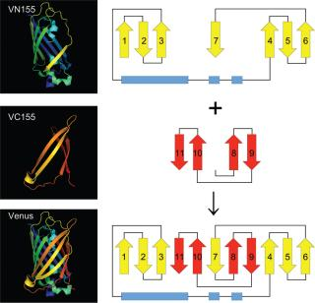
Venus-based BiFC assay
7th β-strand in VN is associated with two β-strands, 8th and 10th, in VC in the BiFC assay
mediated by hydrogen bonds of the backbones and possibly hydrophobic effect of the side chains of the amino acid residues
amino acid substitutions within the 7th β-strand to disrupt some of these interactions would weaken the strength of the association
valine 150 and isoleucine 152 were selected, mutation to leucine
T153M as positive control
Figure 1. Schematic diagram of Venus-based BiFC.

Slide 62
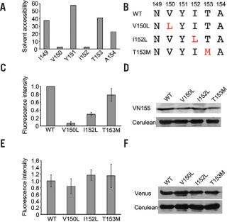
The intensity of fluorescence derived from self-assembly was significantly reduced with V150L and I152L and slightly reduced with T153M (Figure 2C).
Mutation do not greatly affect the expression level of VN (Figure 2D).
introduction of these mutations into the full-length Venus did not affect the overall fluorescence intensity of the mutant Venus when compared with wild-type Venus (Figure 2, E and F).
Figure 2. Identification of mutations to reduce self-assembly between nonfluorescent fragments of Venus.

Slide 63
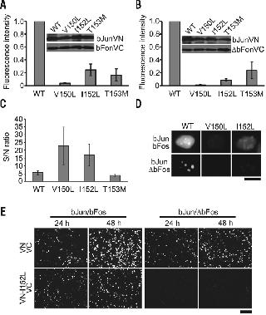
Positive PPI (bJun/bFos) vs Negative PPI (bJun/ΔbFos)
突变体的荧光强度均下降
对阳性组及阴性组的降低程度不同
V150L降低程度太大，不能检验出阳性相互作用
I152L的效果比V150L好
Figure 3. Identification of a mutation for the Venus-based BiFC assay with a high S/N ratio

Slide 64
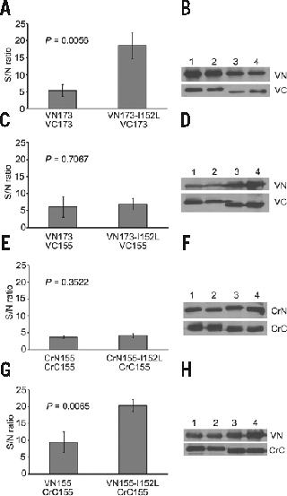
Determine whether the I152L mutation increases the S/N ratio in VN173-based BiFC assays
CrNr155/CrC155(N-terminal or C-terminal fragment of Cerulean ) can pair with Venus
Figure 4. Effect of I152L mutation on VN173- and Cerulean-based BiFCs

Slide 65
Utilization of BiFc assay
Study
post-translational modifications
protein folding
protein aggregation
protein conformational change
protein topology
multiple protein interactions

Slide 66
Regulation of Gene Expression
Gene expression is the process by which RNA is transcribed from DNA and then translated into the structures and functions of a cell (i.e. proteins)
Regulation of gene expression is the cellular control of the amount and timing of the appearance of the functional gene product
Gene regulation is tightly monitored by several specificity factors, activators, and repressors and gives the cell control over structure and function

Slide 67
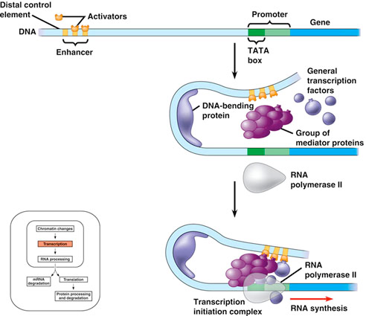
Using BiFC to Study Transcription Regulatory Proteins
Transcriptional regulation involves combinatorial interactions between several transcription factors, which allow for a sophisticated response to multiple conditions in the environment
BiFC analysis has been crucial to understanding the hierarchy of determinants of subcellular localization in different transcription factor families

Slide 68
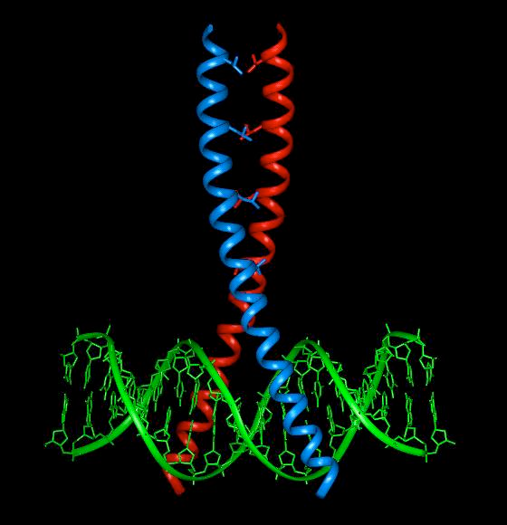
Leucine Zipper Motifs
The leucine zipper motif is a structure made up of two α- helical segments of protein that have leucines facing each other along the length of the helices, allowing them to dimerize and form a symmetric interface that can bind to the DNA on both sides of the double helix
The leucine zipper motif is present in three oncogene products: Fos, Jun and Myc, which all act as transcription factors as part of the AP-1 complex in yeast

Slide 69
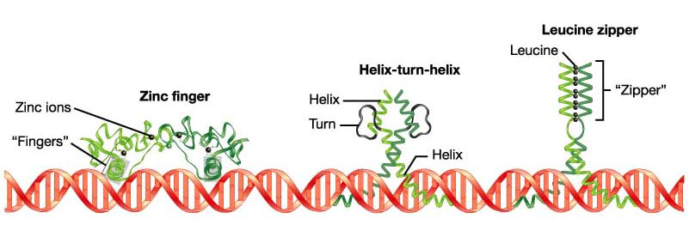
Leucine Zipper Motifs
Leucine zipper regulatory proteins are important regulators of normal development
If they are overproduced or mutated in a vital area, they may generate cancer
These proteins interact with the DNA as dimers (homo- or hetero-) and are also called basic zipper proteins (bZips)

Slide 70
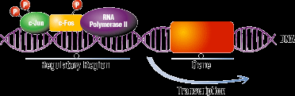
Activator Protein-1 (AP-1)
AP-1 is a transcription factor，belongs to the basic region leucine zipper (bZIP) family of transcription factors and functions as homodimers or heterodimers formed among the members of proteins belonging to the c-Fos, c-Jun, ATF, Maf and JDP families
AP-1 binds to DNA sequences (TRE: transcription response element) in the promotor region of many genes
It regulates gene expression in response to a variety of stimuli, including cytokines, growth factors, stress, and bacterial and viral infections, regulating a wide range of cellular processes including cell proliferation, differentiation, death, and stress responses
Deregulated AP-1 activity is implicated in many human diseases including cancer

Slide 71
4.3 Multicolour BIFC
Proteins X and Z are fused to the N-terminal fragments of two different FPs (fluorescent proteins) (cyan and yellow, respectively); and protein Y (a common binder of proteins X and Z) is fused to the C-terminal fragment of the yellow FP. The complex between X and Y can be distinguished from complex Y–Z due to the differences between the fluorescence spectra of the reassembled FPs

Slide 72
Dual-color trimolecular fluorescence complementation (TriFC)
Combines protein fragments of mCherry and mVenus
Protein A is bilaterally fused to C-terminal fragments of both fluorescent proteins
Protein B is fused to an N-terminal fluorescent protein mCherry fragment
Protein C is fused to an N-terminal fluorescent protein mVenus fragment
the ternary complex formation of the PP2B protein phosphatase Calcineurin-A/Calcineurin-B with Calmodulin-2 was investigated in transiently transformed Nicotiana benthamiana leaf epidermal cells.
The results indicate a Calcineurin-B-induced interaction of Calmodulin-2 with Calcineurin-A.
Visualization and translocation of ternary Calcineurin-A/Calcineurin-B/Calmodulin-2 protein complexes by dual-color trimolecular fluorescence complementation. New Phytologist. 2015

Slide 73
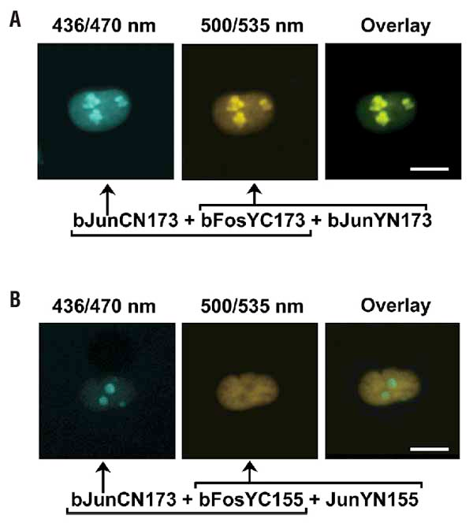
Multicolor BiFC
Many proteins have alternative interaction partners in each cell, many are mutually exclusive and result in competition for shared interaction partners in the cell
Based on complementation between fragments of fluorescent proteins with different spectral characteristics
Allows simultaneous visualization of multiple protein complexes in the same cell
Enables analysis of the competition between alternative interaction partners for complex formation

Slide 74
Multicolor BiFC and bZIP Family
The fluorescence of complexes formed by full-length Jun with the bZIP domain of Fos is shown in green
The fluorescence of complexes formed by the bZIP domain of Jun with the bZIP domain of Fos is shown in red
The complexes exhibit distinct subnuclear distributions in the same cells

Slide 75
Application of BiFC: Determining Subcellular Localization
ATF2 (Activating Transcription Factor 2) belongs to the bZIP family and is a member of AP-1
c-Jun, a proto-oncoprotein, is a major dimerization partner of ATF2
c-Jun-ATF2 heterodimers are responsible for activating target genes involved in stress response, including c-jun
Researchers used BiFC to present evidence that ATF2 monomers and ATF2 homodimers are localized predominantly in the cytoplasm

Slide 76
Application of BiFC: Determining Subcellular Localization
Possesses a nuclear export signal (NES) in its leucine zipper region and two nuclear localization signals (NLS) in its basic DNA-binding region
These signals contribute to the shuttling of the protein between the cytoplasm and the nucleus
Dimerization with c-Jun in the nucleus prevents export of ATF2 and is essential for transcriptional activation of the cjun promoter
ATF2 and c-Jun mutually regulate each other by altering the dynamics of subcellular localization and by positively impacting transcriptional activity

Slide 77
4.4 BRET-BIFC
one interaction partner is fused to a luminescent protein (Renilla luciferase, Rluc) whereas the other two are linked to fragments of the yellow FP
Under normal conditions Rluc oxidizes coelenterazine to colenteramide emitting light. If the three proteins interact forming a multiprotein complex, the reassembled yellow FP can act as receptor of the light emitted by Rluc in a bioluminescent-RET phenomenon

Slide 78
4.5 BIFC-FRET
One interaction partner is linked to a FP (Cyan FP) and each of the other two partners, to a fragment of another FP (in this case, Yellow FP).
If these last two proteins interact, the yellow FP reassembles and recovers its 3D structure and activity.
Then, if the ternary complex is formed, a fluorescence-RET process occurs, where the cyan FP acts as a donor and the yellow FP, as acceptor.

Slide 79
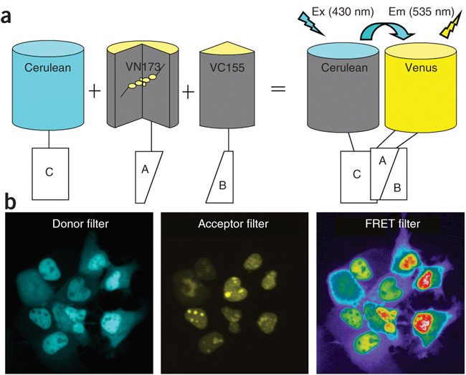
BiFC-based FRET assay
allows visualization of ternary complexes in living cells
Principle of the BiFC–FRET assay. Proteins A and B are fused to the N- and C-terminal nonfluorescent fragments of Venus (VN173 and VC155), respectively, and protein C is fused to the full-length fluorescent protein Cerulean. The interaction between proteins A and B reconstitutes an intact Venus, which serves as a FRET acceptor molecule. The interaction of protein C with A or B or both proteins brings Cerulean (FRET donor) to the proximity of the reconstituted Venus, allowing FRET to take place.
Representative images acquired using donor, acceptor and FRET filters from COS-1 cells cotransfected with plasmids encoding p65-Cerulean, bJun-VN173 and bFos-VC155 are shown. Protein interaction between bJun and bFos drives the reconstitution of the Venus fluorescent protein (middle). Formation of ternary complexes between p65 and bJun-bFos heterodimer allows the FRET signal to be detected when donor excitation is applied (right). Red color indicates high FRET signal.
Nature protocol 2008, 3(11):1693-1702

Slide 80
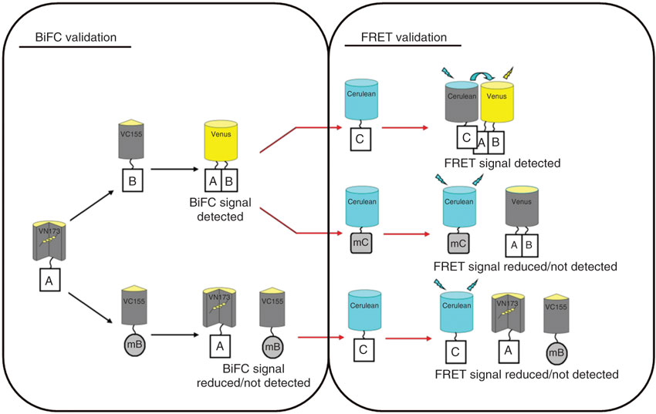
A-B interaction
A-mutated B no interaction
Notes:
80
If BiFC signals reflect a specific interaction between proteins A and B, mutations introduced into the interaction interface for one of the two proteins (e.g., mB) should abolish or significantly decrease the BiFC signal (left box). Once the BiFC constructs and mutant control(s) are validated, the third protein (e.g., protein C) and its mutant form (mC) can be fused to the full-length protein Ceruelan for FRET validation. If a ternary complex is formed between all three proteins, a FRET signal may be generated, whereas the mutant controls should show a significantly decreased FRET signal (right box). Note that nonfluorescent fragments VN173 and VC155 as well as the full-length Cerulean can be fused to either the N- or C-terminal end of proteins of interest during the optimization process. If the interaction of proteins A and B is not validated, interactions between proteins A and C or B and C should be similarly tested

Slide 81
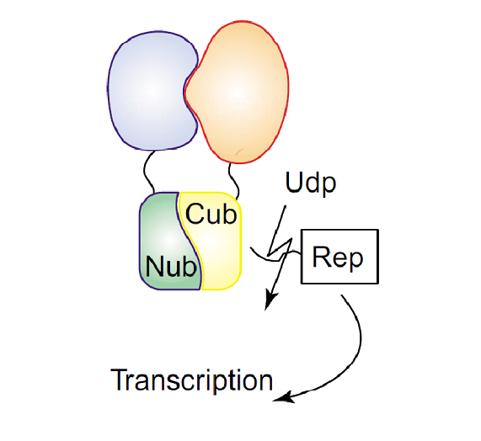
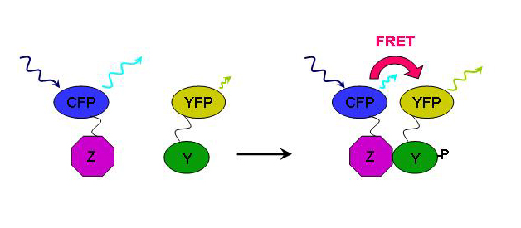
思考题
Which methods we studied belong to protein complementation assays?
Which methods can be used to detect protein-protein interactions in vivo?
The concepts and Principles of FRET, BRET, BiFC, BiFC-BRET, BiFC-FRET, PCA, etc.
Compare FRET and BRET; BiFC-BRET and BiFC-FRET; BiFC and split Biolumincent protein assay
看图写实验名称，说明其原理及应用
Notes:
protein complementation assays:
RET, resonance energy transfe
BIFC-RET, BIFC-based resonance energy transfer
AP/MS, affinity purification followed by mass spectrometry
Y2H, yeast two-hybrid

Slide 82
PCAs for high-throughput screening
The bait protein fused to one of the reporter fragments is screened against a cDNA library fused to the complementary portion

Slide 83
Successfully identify novel substrates and regulators of the serine/threonine protein kinase PKB/Akt

Slide 84
Objectives: Pancreatic ductal adenocarcinoma (PDAC) has been subclassified into 3 molecular subtypes: classical, quasi-mesenchymal, and exocrine-like. These subtypes exhibit differences in patient survival and drug resistance to conventional therapies. The aim of the current study is to identify novel subtype-specific protein biomarkers facilitating subtype stratification of patients with PDAC and novel therapy development.
Methods: A set of 12 human patient-derived primary cell lines was used as a starting material for an advanced label-free proteomics approach leading to the identification of novel cell surface and secreted biomarkers. Cell surface protein identification was achieved by in vitro biotinylation, followed by mass spectrometric analysis of purified biotin-tagged proteins. Proteins secreted into a chemically defined serum-free cell culture medium were analyzed by shotgun proteomics.
Results: Of 3288 identified proteins, 2 pan-PDAC (protocadherin-1 and lipocalin-2) and 2 exocrine-like-specific (cadherin-17 and galectin-4) biomarker candidates have been validated. Proximity ligation assay analysis of the 2 exocrine-like biomarkers revealed their co-localization on the surface of exocrine-like cells.
Conclusions: The study reports the identification and validation of novel PDAC biomarkers relevant for the development of patient stratification tools. In addition, cadherin-17 and galectin-4 may serve as targets for bispecific antibodies as novel therapeutics in PDAC.

